Slide 1
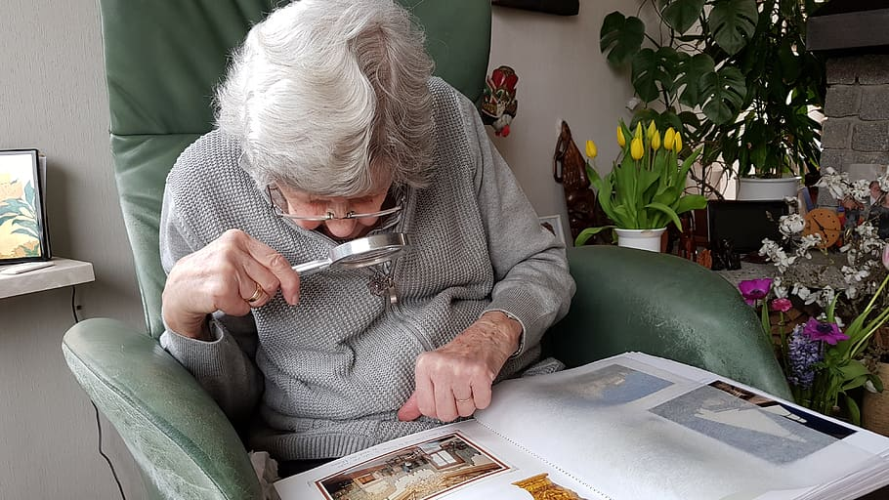
CPE-695-WS Applied Machine Learning, Team: 4
Assisting Partially blind people using Machine Learning
Instructor:
Shucheng Yu
Members:
Vinoth Kumar Kolluru
Soukya Boreddy
Sathya Narayanan Sriram

Slide 2

AGENDA:
Problem Statement
List of Packages
Data Classification
Project Implementation
Results and Future Work
Q&A

Slide 3
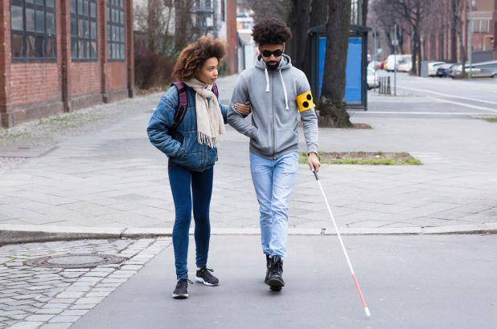
Problem Statement
You might be interested in these?
To Serve visually challenged people by recognizing the mode of communication and converting it to audio/voice output

Slide 4
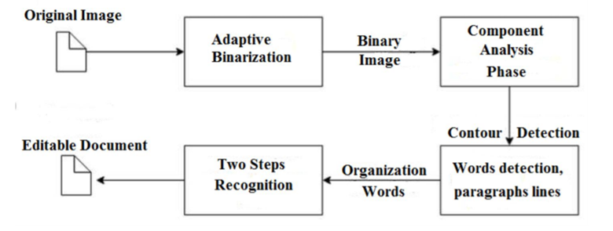
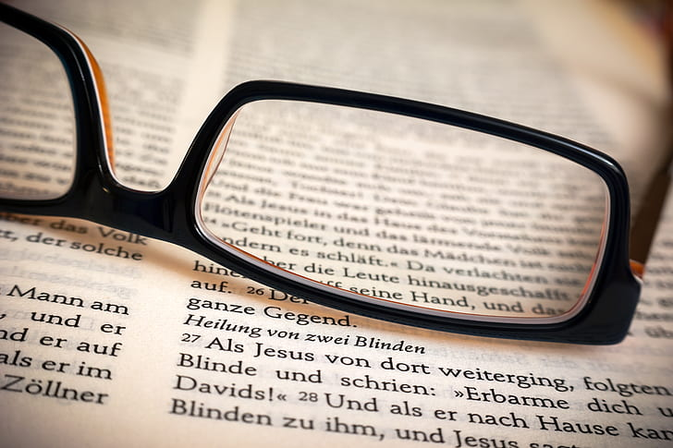
Overview

Slide 5
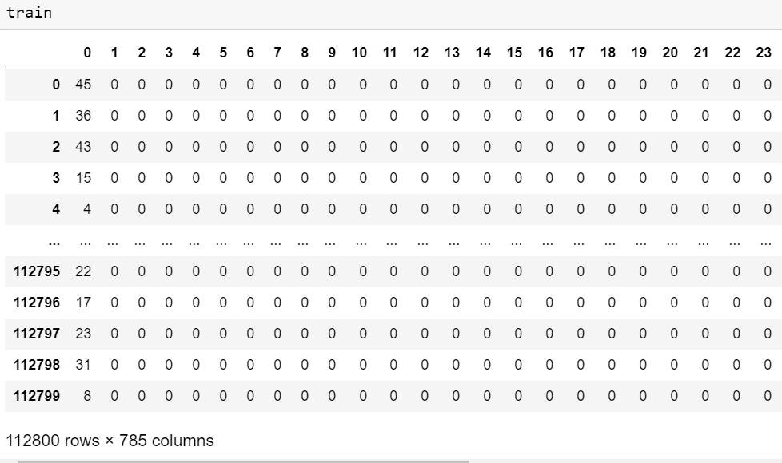
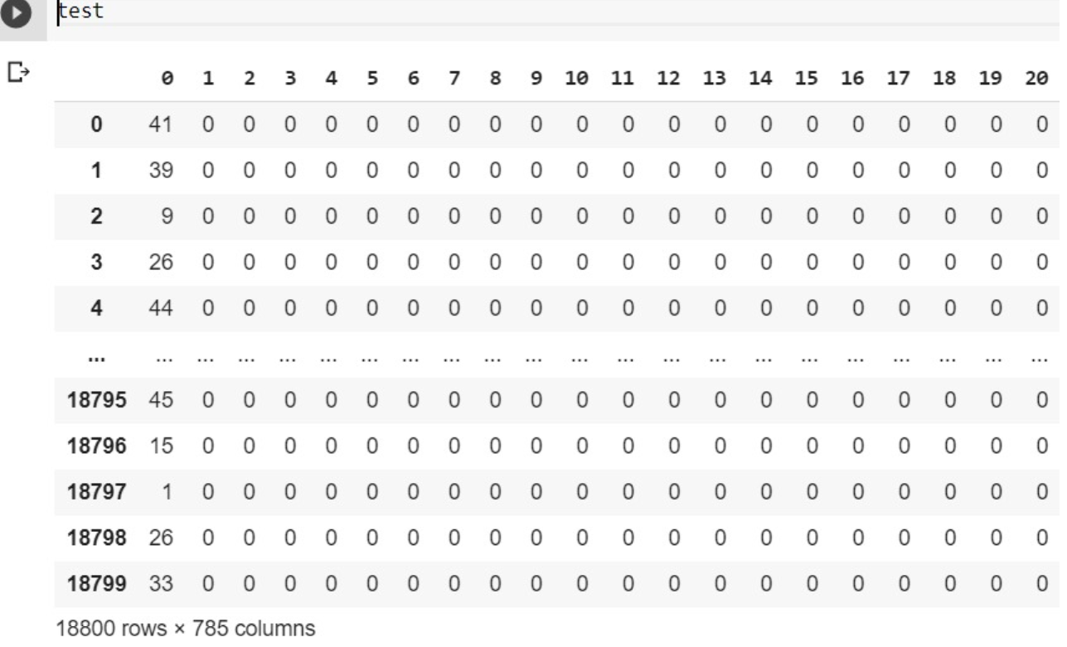
Identification of Datasets
https://www.kaggle.com/crawford/emnist#emnist-balanced-test.csv
Train Dataset
Test Dataset

Slide 6

List of Packages
Pandas
Matplotlib
Numpy
Utils
Tensorflow
Tensorflow.keras
PIL (Python Imaging Library)
CSV (to import any CSV format data)
Sys (to import System Specific parameters and functions)

Slide 7

Data Classification
Classify the data into Training and Test data set
Map the ASCII values
Create a Model

Slide 8
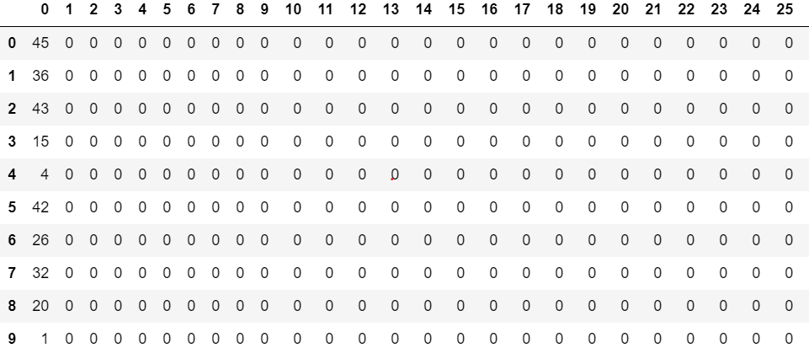
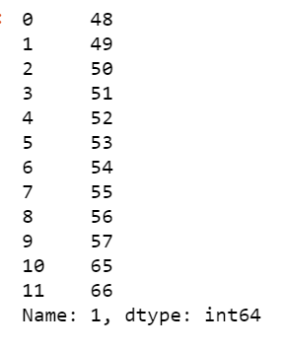
Data Pre-Processing:
Binary conversion for ASCII Codes
Desired ASCII mapping file

Slide 9
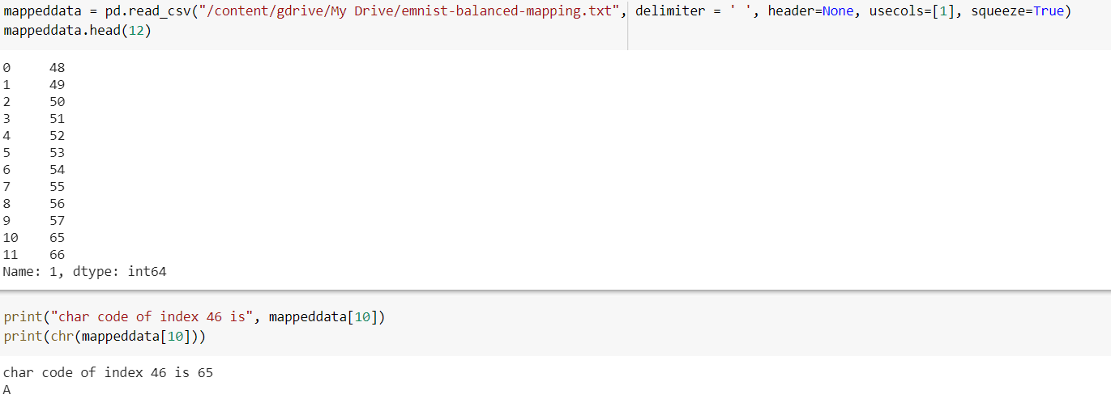
Data Mapping:

Slide 10
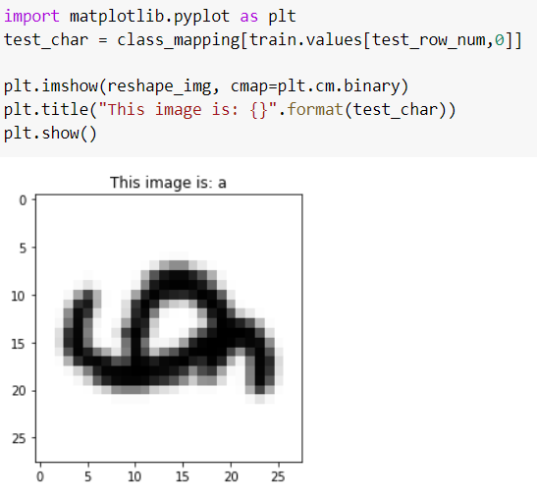
Singular Image:

Slide 11
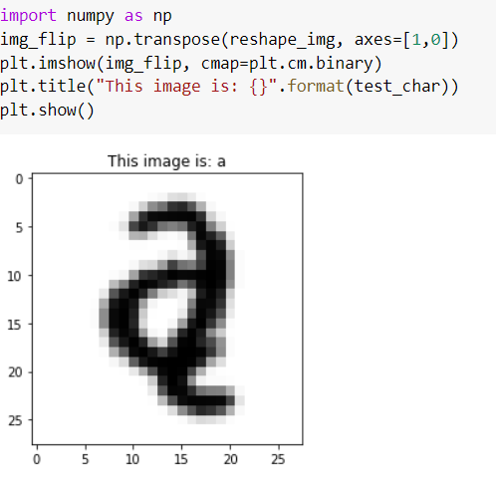
Transpose the matrix of pixels into its correct position

Slide 12
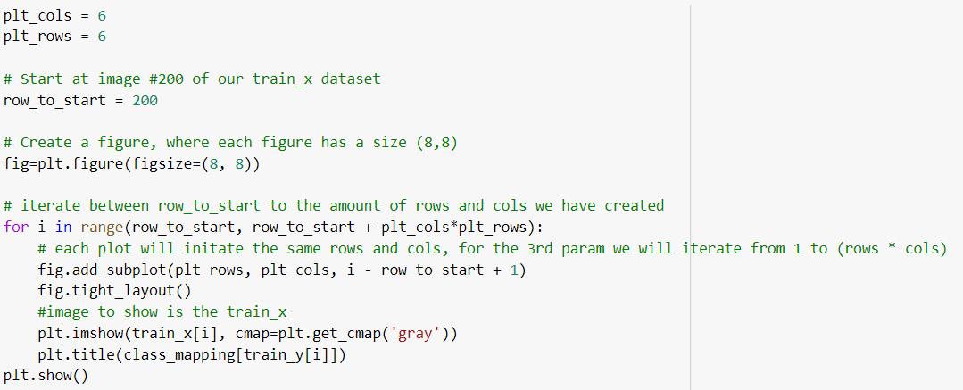
Checking with few Train data

Slide 13
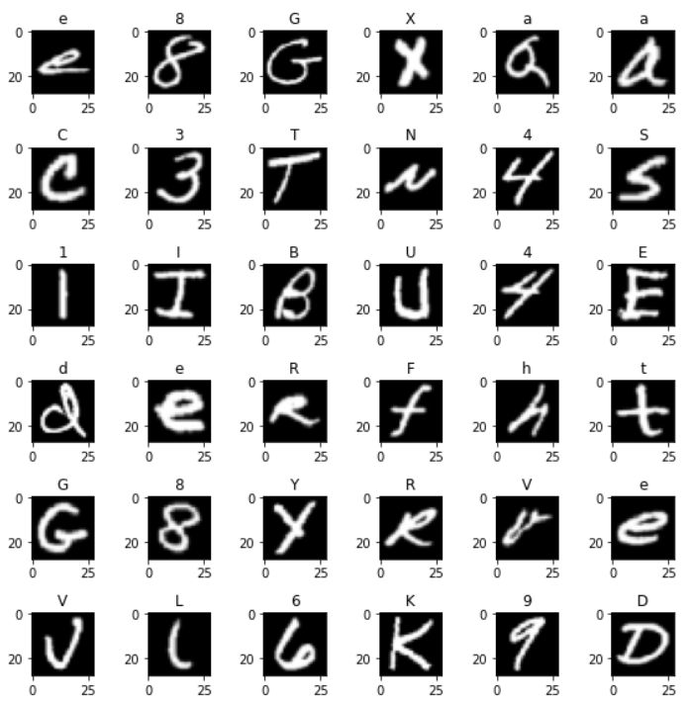
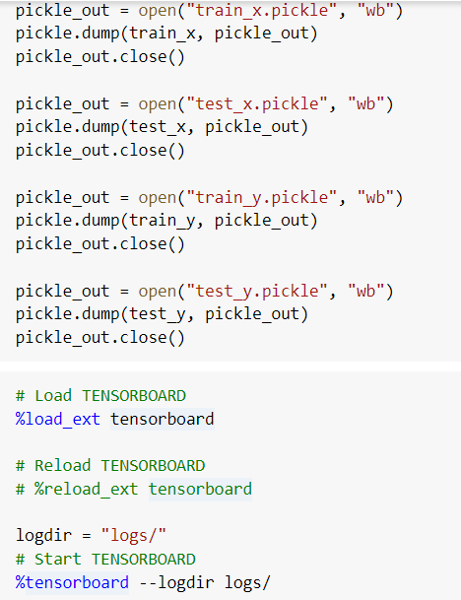
Few Train data images
Load the data into pickle

Slide 14
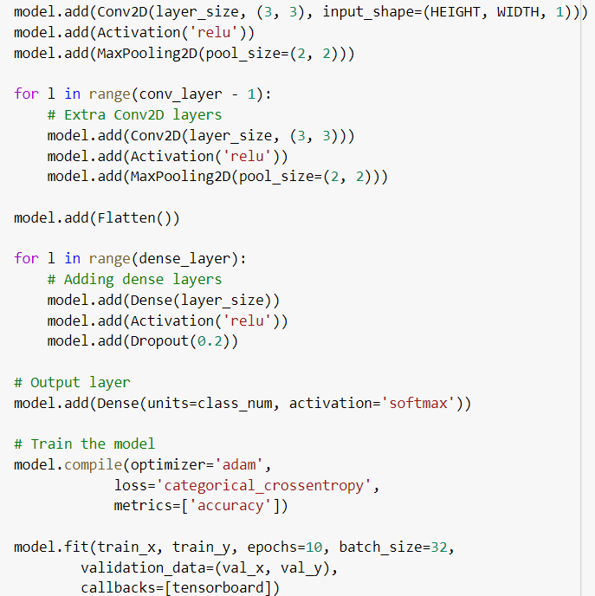
Model created using Neural network
2 Convolutional layers
2 Dense layers
0.2 Dropout
128 Nodes per layer

Slide 15
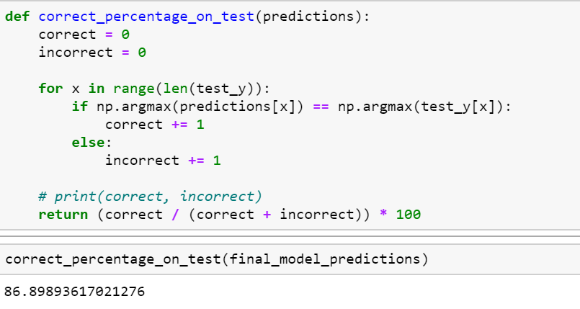
Model Accuracy: 86.89

Slide 16
Project Implementation
The above created model is tested with random images and concluded with an accuracy of 86.89 %.
Following this is the step of converting input images into csv and feed them for the model to generate the required output of the image converted into text format.
The conversion of image to CSV is done by converting the image into 2D numpy arrays and saving them as txt file with .CSV extension.
This CSV file is feeded into the model and the output, a text file is generated.

Slide 17
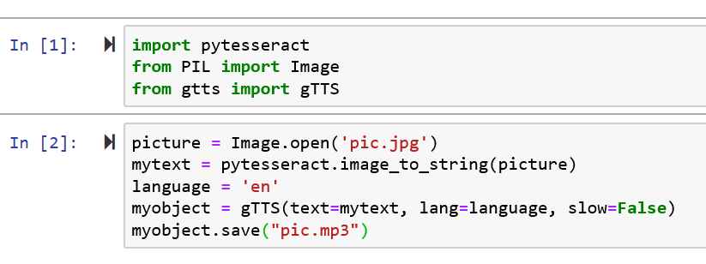
Image to Audio Conversion
The output generated in the first generated model is fed into “tesseract”, which is an optical character recognition engine.
After recognising the text, we use GTTS package, which is “Google Text-to-Speech”, a python library.

Slide 18
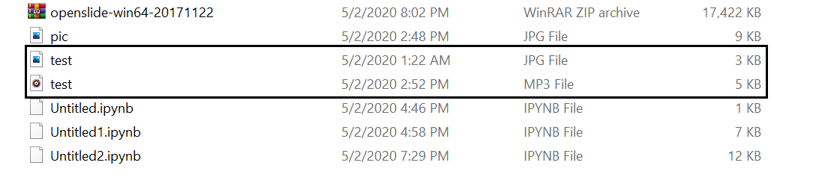
Result
The above code which uses Pytesseract and Google Text-to-Speech, converts the text input fed into mp3 audio file and saves it in the same directory in which the text file is present.
In the above screenshot, we can see that there is an image “test” in JPG format and after the image has been fed to the model, the output audio file named the same in MP3 format has been generated.

Slide 19


Slide 20
THANK YOU!

